Slide 1
Chapter 10.5
Euler and Hamilton Paths
Based on Discrete Mathematics and Its Applications, 7th ed., by Kenneth H. Rosen, published by McGraw Hill, Boston, MA, 2011.

Slide 2
Euler Paths and Circuits
The Seven bridges of Königsberg, Prussia (now called Kaliningrad and part of the Russian republic)
c
C
D
d
a
A
b
B
The townspeople wondered whether it was possible to start at some location in the town, travel across all the bridges once without crossing any bridge twice, and return to the starting point .
The Swiss mathematician Leonhard Euler solved this problem. His solution, published in 1736, may be the first use of graph theory.

Slide 3
Euler Paths and Circuits
An Euler path is a path using every edge of the graph G exactly once.
An Euler circuit is an Euler path that returns to its start.
C
Does this graph have an Euler circuit?
A
D
No.
B

Slide 4
Necessary and Sufficient Conditions
How about multigraphs?
A connected multigraph has a Euler circuit iff each of its vertices has an even degree.
A connected multigraph has a Euler path but not an Euler circuit iff it has exactly two vertices of odd degree.
We will first see some examples,
then the proof in the book starting on p. 694.

Slide 5
Example
Which of the following graphs has an Euler circuit?
a
b
a
b
a
b
e
e
d
c
d
c
c
d
e
yes no no
(a, e, c, d, e, b, a)

Slide 6
Example
Which of the following graphs has an Euler path?
a
b
a
b
a
b
e
e
d
c
d
c
c
d
e
yes no yes
(a, e, c, d, e, b, a ) (a, c, d, e, b, d, a, b)

Slide 7
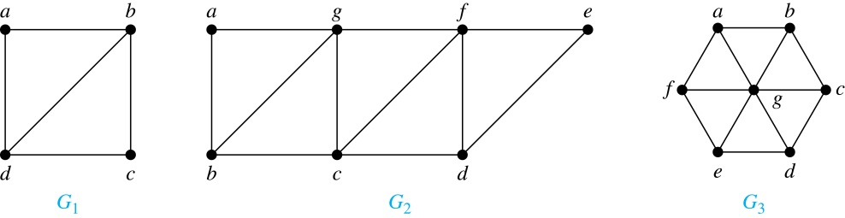
Euler Paths
Example:
G₁ contains exactly two vertices of odd degree (b and d). Hence it has an Euler path, e.g., d, a, b, c, d, b.
G₂ has exactly two vertices of odd degree (b and d). Hence it has an Euler path, e.g., b, a, g, f, e, d, c, g, b, c, f, d.
G₃ has six vertices of odd degree. Hence, it does not have an Euler path.

Slide 8
Necessary Conditions for Euler Circuits and Paths
We assume that a connected multigraph has an Euler circuit.
An Euler circuit begins with a vertex a and continues with an edge incident with a, say {a, b}. The edge {a, b} contributes one to deg(a).
Each time the circuit passes through a vertex it contributes two to the vertex’s degree.
Finally, the circuit terminates where it started, contributing one to deg(a). Therefore deg(a) must be even.
We conclude that the degree of every other vertex must also be even.
By the same reasoning, we see that the initial vertex and the final vertex of an Euler path have odd degree, while every other vertex has even degree. So, a graph with an Euler path has exactly two vertices of odd degree.
In the next slide we will show that these necessary conditions are also sufficient conditions.

Slide 9
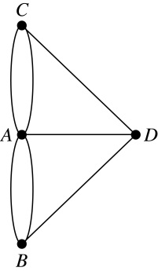
Necessary and Sufficient Conditions for Euler Circuits and Paths (continued)
Theorem: A connected multigraph with at least two vertices has an Euler circuit if and only if each of its vertices has an even degree and it has an Euler path if and only if it has exactly two vertices of odd degree.
Example: Two of the vertices in the multigraph model of the Kӧnigsberg bridge problem have odd degree. Hence, there is no Euler circuit in this multigraph and it is impossible to start at a given point, cross each bridge exactly once, and return to the starting point.

Slide 10
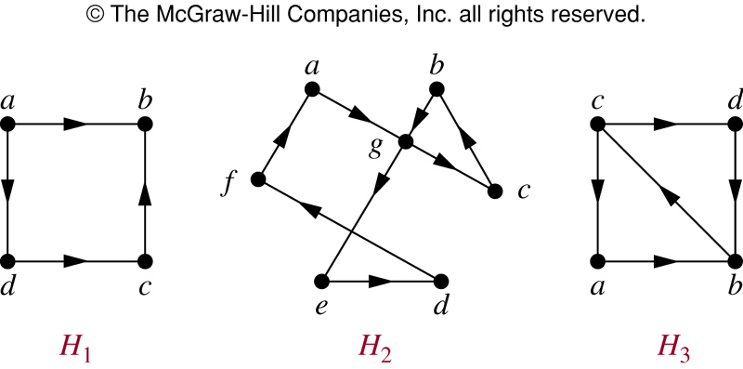
Euler Circuit in Directed Graphs
NO (a, g, c, b, g, e, d, f, a) NO

Slide 11
Euler Path in Directed Graphs
NO (a, g, c, b, g, e, d, f, a) (c, a, b, c, d, b)

Slide 12
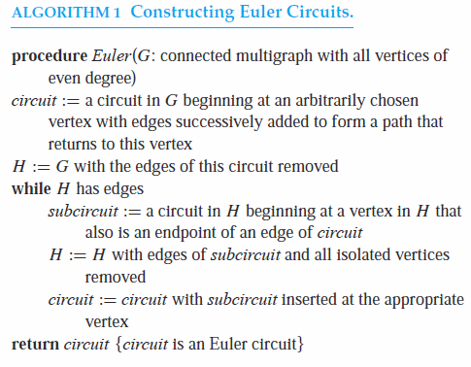
THEOREM 1. A connected multigraph with at least two vertices has an Euler circuit if and only if each of its vertices has even degree.
The proof starts on p. 694 in the book.
It is constructive and leads to the following

Slide 13
Applications of Euler Paths and Circuits
Euler paths and circuits can be used to solve many practical problems such as finding a path or circuit that traverses each
street in a neighborhood,
road in a transportation network,
connection in a utility grid,
link in a communications network.
Other applications are found in the
layout of circuits,
network multicasting,
molecular biology, where Euler paths are used in the sequencing of DNA.

Slide 14
Hamilton Paths and Circuits
A Hamilton path in a graph G is a path which visits every vertex in G exactly once.
A Hamilton circuit is a Hamilton path that returns to its start.

Slide 15
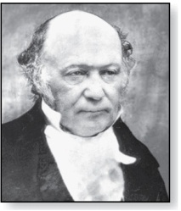
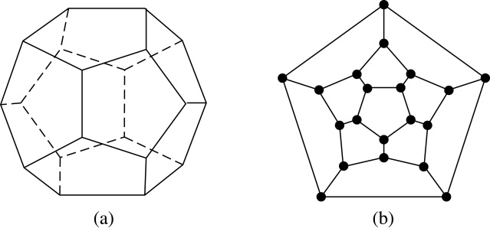
Hamilton Paths and Circuits
William Rowan Hamilton (1805- 1865)
Euler paths and circuits contained every edge only once. Now we look at paths and circuits that contain every vertex exactly once.
William Hamilton invented the Icosian puzzle in 1857. It consisted of a wooden dodecahedron (with 12 regular pentagons as faces), illustrated in (a), with a peg at each vertex, labeled with the names of different cities. String was used to used to plot a circuit visiting 20 cities exactly once
The graph form of the puzzle is given in (b).
Definition: A simple path in a graph G that passes through every vertex exactly once is called a Hamilton path, and a simple circuit in a graph G that passes through every vertex exactly once is called a Hamilton circuit.

Slide 16
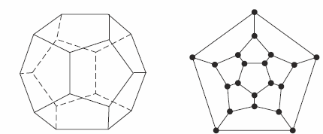
Hamilton Circuits
Dodecahedron puzzle and it equivalent graph
Is there a circuit in this graph that passes through each vertex exactly once?

Slide 17
Dodecahedron is a polyhedron with twelve flat faces

Slide 18
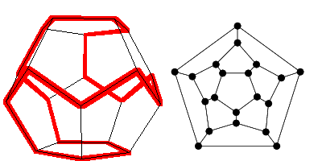
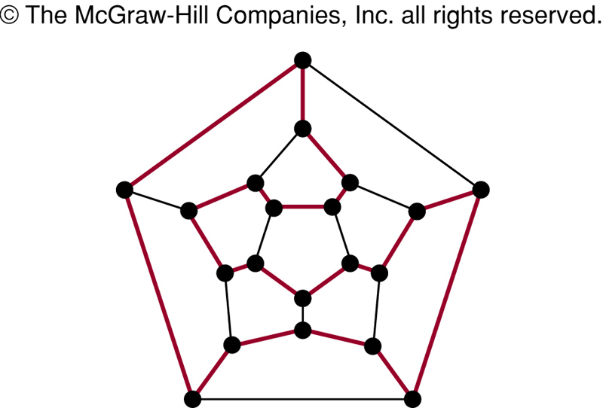
Hamilton Circuits
Yes; this is a circuit that passes through each vertex exactly once.

Slide 19
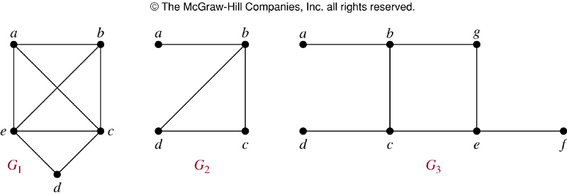
Finding Hamilton Circuits
Which of these three figures has a Hamilton circuit? Or, if no Hamilton circuit, a Hamilton path?

Slide 20
Finding Hamilton Circuits
G₁ has a Hamilton circuit: a, b, c, d, e, a
G₂ does not have a Hamilton circuit, but does have a Hamilton path: a, b, c, d
G₃ has neither.

Slide 21

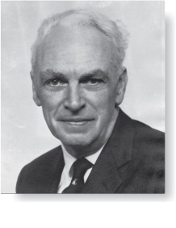
Necessary Conditions for Hamilton Circuits
Gabriel Andrew Dirac
(1925-1984)
Unlike for an Euler circuit, no simple necessary and sufficient conditions are known for the existence of a Hamiton circuit.
However, there are some useful necessary conditions. We describe two of these now.
Dirac’s Theorem: If G is a simple graph with n ≥ 3 vertices such that the degree of every vertex in G is ≥ n/2, then G has a Hamilton circuit.
Ore’s Theorem: If G is a simple graph with n ≥ 3 vertices such that deg(u) + deg(v) ≥ n for every pair of nonadjacent vertices, then G has a Hamilton circuit.
Øysten Ore
(1899-1968)

Slide 22
Finding Hamilton Circuits
Unlike the Euler circuit problem, finding Hamilton circuits is hard.
There is no simple set of necessary and sufficient conditions, and no simple algorithm.

Slide 23
Properties to look for ...
No vertex of degree 1
If a node has degree 2, then both edges incident to it must be in any Hamilton circuit.
No smaller circuits contained in any Hamilton circuit (the start/endpoint of any smaller circuit would have to be visited twice).

Slide 24
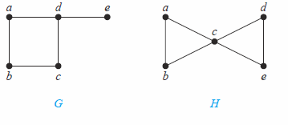
Show that neither graph displayed below has a Hamilton circuit.
There is no Hamilton circuit in G because G has a vertex of degree one: e.
Now consider H. Because the degrees of the vertices a, b, d, and e are all two, every edge incident with these vertices must be part of any Hamilton circuit. No Hamilton circuit can exist in H, for any Hamilton circuit would have to contain four edges incident with c, which is impossible.

Slide 25
A Sufficient Condition
Let G be a connected simple graph with n vertices with n ≥ 3.
If the degree of each vertex is ≥ n/2,
then G has a Hamilton circuit.

Slide 26
Applications of Hamilton Paths and Circuits
Applications that ask for a path or a circuit that visits each intersection of a city, each place pipelines intersect in a utility grid, or each node in a communications network exactly once, can be solved by finding a Hamilton path in the appropriate graph.
The famous traveling salesperson problem (TSP) asks for the shortest route a traveling salesperson should take to visit a set of cities. This problem reduces to finding a Hamilton circuit such that the total sum of the weights of its edges is as small as possible.
A family of binary codes, known as Gray codes, which minimize the effect of transmission errors, correspond to Hamilton circuits in the n-cube Q_{n}. (See the text for details.)

Slide 27
Travelling Salesman Problem
A Hamilton circuit or path may be used to solve practical problems that require visiting “vertices”, such as:
road intersections
pipeline crossings
communication network nodes
A classic example is the Travelling Salesman Problem – finding a Hamilton circuit in a complete graph such that the total weight of its edges is minimal.

Slide 28
Time Complexity
The best algorithms known for finding a Hamilton circuit in a graph or determining that no such circuit exists have exponential worst-case time complexity (in the number of vertices of the graph).
Finding an algorithm that solves this problem with polynomial worst-case time complexity would be a major accomplishment because it has been shown that this problem is NP-complete. Consequently, the existence of such an algorithm would imply that many other seemingly intractable problems could be solved using algorithms with polynomial worst-case time complexity.

Slide 29
Summary
Property | Euler | Hamilton
Repeated visits to a given node allowed? | Yes | No
Repeated traversals of a given edge allowed? | No | No
Omitted nodes allowed? | No | No
Omitted edges allowed? | No | Yes

